Slide 1
LMS Algorithm, Adaline and Madline
TE-AIDS
Subject: Artificial Neuron Network
Prof. Shilpa Gaikwad

Slide 2
ADALINE
ADALINE stands for Adaptive Linear Neuron.
It is also called Adaptive Linear Element.
This ADALINE network was developed by Professor Bernard Widrow and Tedd Hoff at the Stanford University in 1960.
It is based on McCulloch Pitts neuron and consists of weights, bias and summing junctions.

Slide 3
The structure of ADALINE.
A single layer ADALINE consists of inputs, a summing junction, where the weighted sum of the inputs are taken.
where
x0 is the bias and is always equal to 1.
x1 and x2 are the inputs
w0, w1, w2 are the corresponding weights.
Now to calculate the error, we take the output of the summing junction and subtract it from the desired output given by a supervisor or we can call it a teacher.

Slide 4
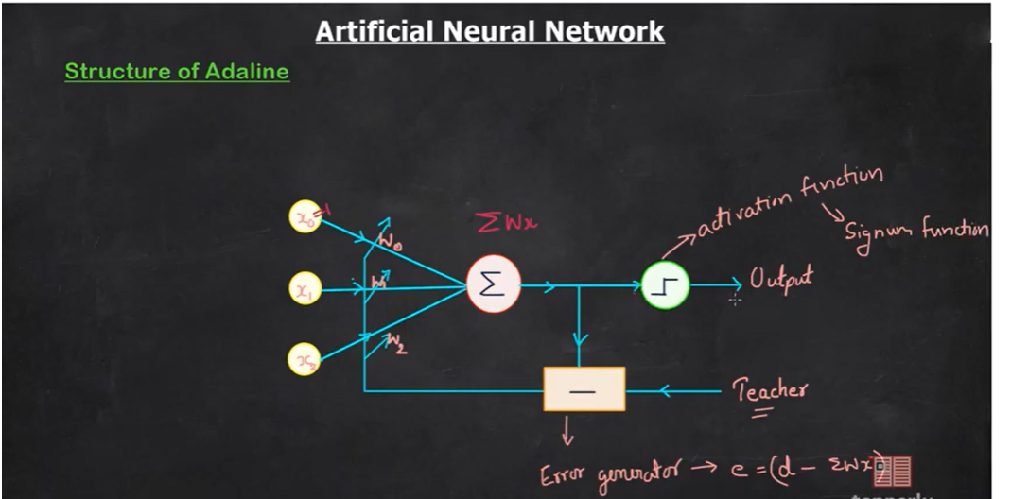
The structure of ADALINE

Slide 5
The structure of ADALINE
Therefore this is the error generator and here we calculate the error.
Now, this error will be used to update the weights w0,w1 and w2.
Therefore this error at the output will be fed back to the network.
This error which is fed back to the network so that the weights are updated.

Slide 6
The structure of ADALINE
Now note that in practical circuits, we often have a hard limiter at the output to prevent saturation.
Usually this hard limiter is called activation function.
The most common activation function used for ADALINE is signum function.
Even though the output of the neuron is taken after the activation function, for the calculation of error we take the output from the summing junction.

Slide 7
The structure of ADALINE
This is an important point and it distinguishes the ADALINE network from usual perceptron.
The error from the error generated is used to update the weights.
But how do we do that? For that, we have the LMS algorithm.
LMS algorithm also called Least Mean Square algorithm.

Slide 8
LMS algorithm
From the Delta (Δ) rule, we know that E(w) is the cost function.
It is also called Energy function.
So lets first define an energy function E(w) where
w stands for the weight vector
E(w)=1/2(e²)
Where e is given e=d- x^T (Desired output –x Transpose)
where x is the input vector and x may consist of many input elements x1, x2 etc. to xn.
Similarly w is the weight vector and w consist of w1, w2 etc. to wn.
Or it can start from x0, x1, etc. to xn. and w0, w1 etc. to wn.
We are using this cap(^) to denote that this is a gradient approximation.

Slide 9
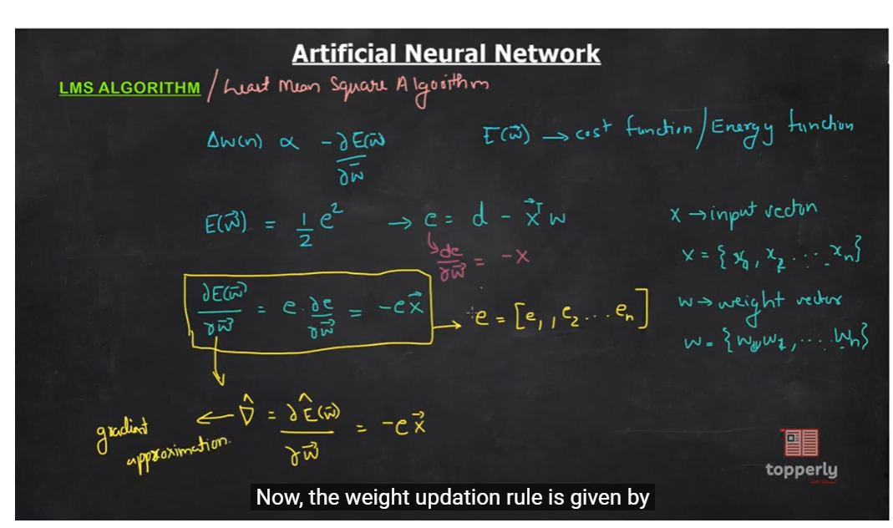
LMS algorithm

Slide 10
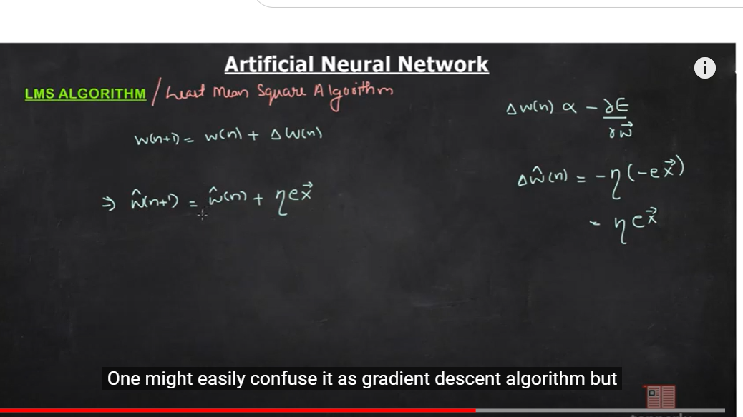
LMS Algorithm
Now, the weight updation rule is given by

Slide 11
LMS algorithm
For gradient descent, a definite trajectory is obtained.
However, since here we are approximating the w's, the trajectory may not be as good as the gradient descent.
There will be some randomness associated with it.
So if you draw a contour plot, let this be W1 and this be W2.

Slide 12
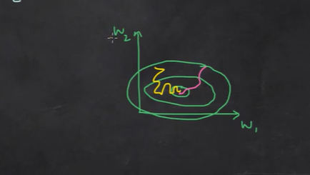
LMS algorithm

Slide 13
LMS algorithm
Unlike in the case of gradient descent where there was a definite smooth trajectory, in the case of LMS algorithm the trajectory may be very sluggish.
So we can say that even though the LMS approach is in tune with the gradient descent, it is not exactly gradient descent.
For this reason, it is also called stochastic gradient descent.
LMS algorithm is the practical implementation of gradient descent algorithm.

Slide 14
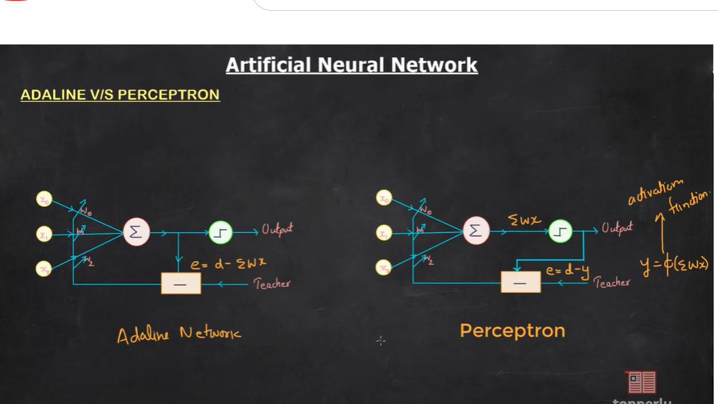
ADALINE vs perceptron

Slide 15
ADALINE vs perceptron
The only difference between ADALINE and perceptron is on the basis of how the weights are updated.
In the case of ADALINE networks, in the learning phase, the weights are adjusted according to the weighted sum of the inputs.
i.e the sigma (Σ) is calculated and the error is calculated on the basis of e=d-∑wx --------→ (desired output-∑wx).
So this is ADALINE network.

Slide 16
ADALINE vs perceptron
However, in the case of standard perceptron, the net Σwx is passed through an activation function and the activation function's output is used for adjusting the weights.
Therefore here error is calculated on the basis of d-y where y is the output and Φ is the activation function.
y= Φ(∑wx)
This is the difference between ADALINE and perceptron.

Slide 17
MADALINE
MADALINE is a multi-layer network of ADALINEs.
MADALINE stands for Many ADALINE where the M stands for Many.
So going to the standard definition, if you look at the structure of MADALINE, it is something like this.
There are input neurons.
This is the input layer and there is a hidden layer consisting of ADALINE units and there is an output layer which is also made of ADALINE units.

Slide 18
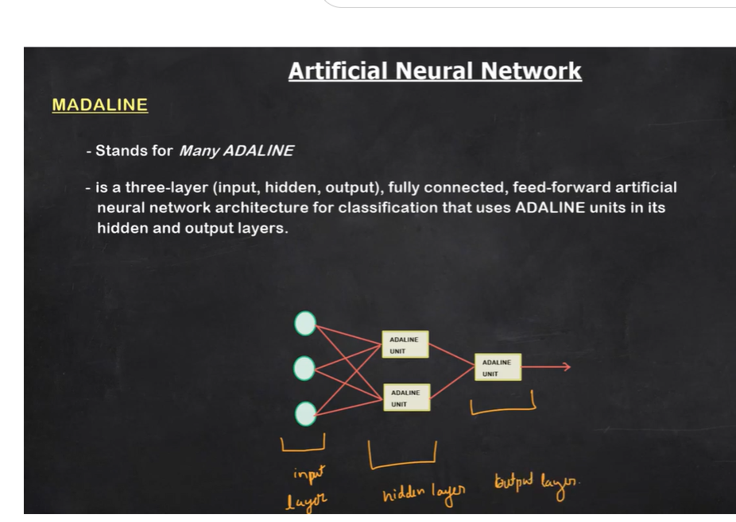
MADALINE

